Slide 1
Refactoring RPG
What, Why and How
Ted Holt
Senior Software Developer, Profound Logic Software
Senior Technical Editor, itjungle.com

Slide 2
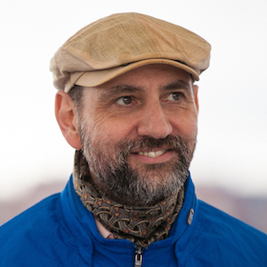
What is refactoring?
". . . a change made to the internal structure of the software to make it easier to understand and cheaper to modify without changing its observable behavior." - Martin Fowler, author of Refactoring: Improving the Design of Existing Code

Slide 3
What is refactoring?
Nothing new
First use of the term in publication was in September, 1990.
Often begins with a “code smell” (red flag)

Slide 4
What is refactoring?
For example:
Replacing an outdated feature (the SUBST opcode) with a newer feature (the %SUBST function)
Renaming variables to longer, more-descriptive names
Creating a subprocedure from a section of code

Slide 5
What is refactoring NOT?
Refactoring is not:
Debugging (Refactor working code only!)
Enhancing (Do NOT make enhancements while refactoring!)

Slide 6
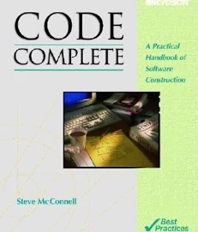
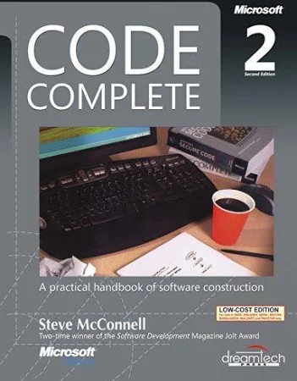
Bet you didn't know . . .
Code Complete (Steve McConnell, 1993) did not mention refactoring.
Code Complete 2
(Steve McConnell, 2004) has an entire chapter devoted to the subject.

Slide 7
Why refactor?
A needed change or enhancement is not possible or is very difficult with the code in its present form.
Rewriting code is sometimes necessary to determine what task is accomplished (to decipher the program "logic")

Slide 8
Why NOT to refactor
“That's not the way I would have done it.”

Slide 9
The only reason to refactor
There must be a business case!

Slide 10
The process
Begin
Rewrite some source code
Test
Same behavior?
No
Yes
More change needed?
Yes
No
Finished!

Slide 11
The process
Establish a baseline.
If the routine produces output, great! If not, add temporary output.
Test all conditions.
Your input data must exercise every path through the code.
Test often.
Doing a little at a time introduces fewer errors.

Slide 12
Common refactorings
Divide into smaller units (.e.g. a section of code into a subroutine or subprocedure)
Convert a subroutine to a subprocedure
Replace GOTO with structured code
Eliminate global variables

Slide 13
Common refactorings
Eliminate deep nesting
C END
C END
C END
C END
C END
C END
C END
C END
C END
C END
C END
C END
From a real production program!

Slide 14
Common refactorings
Convert duplicate code into a subprocedure
Remove or rename indicators
Rename identifiers (giving better names to variables, constants, subroutines, and subprocedures)
Replace literals with named constants

Slide 15
Sorta-kinda refactorings
Convert RPG II/III to RPG IV (CVTRPGSRC)
Convert fixed-format RPG to free-form
Remove dead code (RNF7031 helps)
Add white space
Remove commented-out code

Slide 16
Refactoring identifiers
Replace six-character names (variables, subroutines) with longer, more legible names.
RDi can help

Slide 17
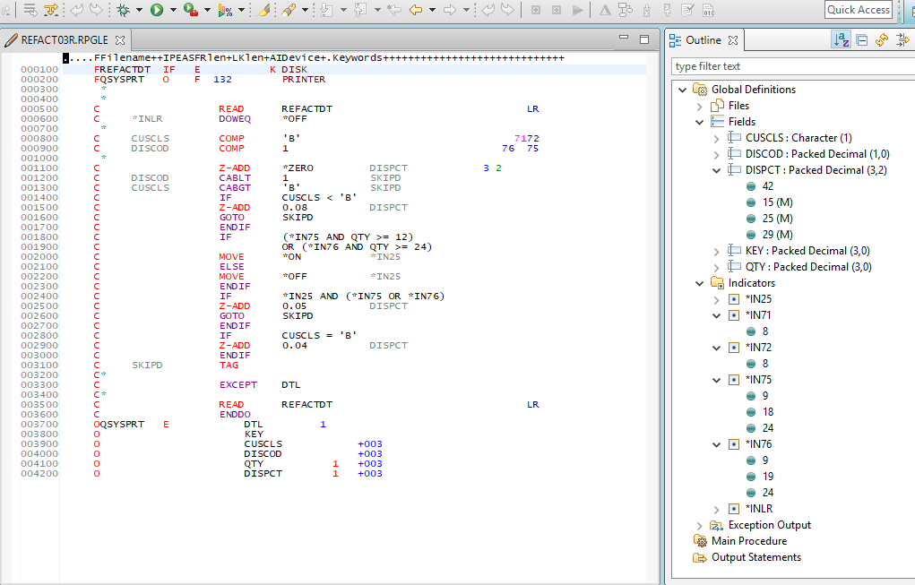
Refactoring identifiers
The outline view shows you where fields, variables and indicators are used.

Slide 18
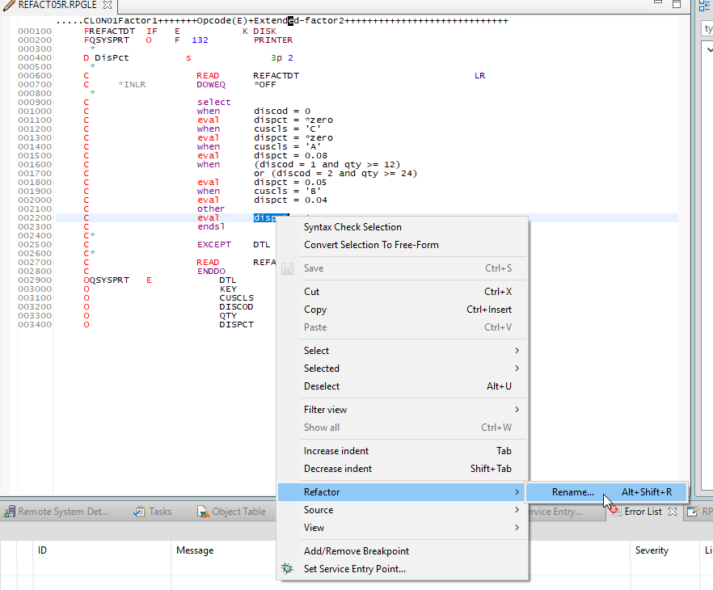
Refactoring identifiers
The context menu includes a Refactoring submenu.

Slide 19
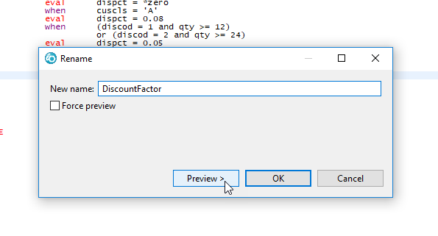
Refactoring identifiers
Enter the new name.

Slide 20
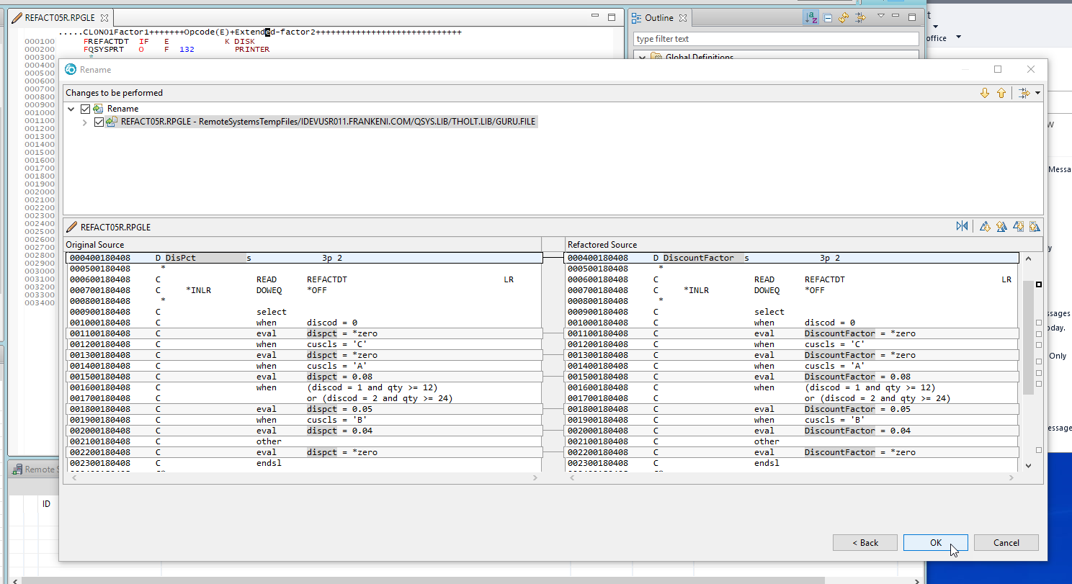
Refactoring identifiers
Click through the next panel to see what changes.
Current code
Revised code

Slide 21
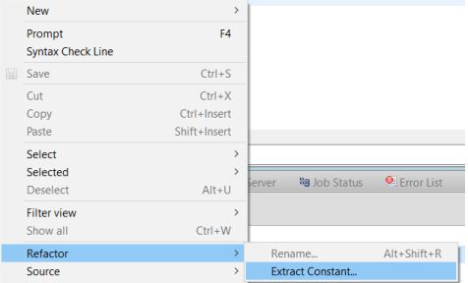
Refactoring literals
Replace a literal with a named constant.
New with RDi 9.6.0.6!!

Slide 22
Refactoring indicators
The problems:
Indicators are global. (Anything can change them.)
Indicators are non-descriptive. (What does *IN20 mean?)

Slide 23
Refactoring indicators
Techniques
Replace with built-in functions %EOF and %FOUND.
Remove unused indicators. (Look for RNF7031 in the compiler listing.)
Use INDARA for device files.
Rename numeric indicators.
Move indicators out of input and output specs and into calculations.
Replace conditioned literals with fields.

Slide 24
Refactoring indicators
For more information:
The New Basics: Indicators
Jon Paris
https://www.itjungle.com/2012/09/19/fhg091912-story01/

Slide 25
Refactoring into routines
Aim for reusability of object code.
Convert inline code to a subroutine.
Convert inline code or a subroutine into a subprocedure.
Convert inline code or a subroutine into a called program.

Slide 26
Refactoring into routines
Good!
Inline code
Better!!
Subroutines
Best!!
Subprocedures

Slide 27
Refactoring into a subprocedure
Eliminate global variables.
Any variable that is only used within the routine becomes a local variable.
dcl-proc CalcDiscount;
dcl-s DisPct packed (3:2);
. . . more code . . .
end-proc CalcDiscount;

Slide 28
Refactoring into a subprocedure
Eliminate global variables.
Any variable that is used both inside and outside the routine becomes a parameter.
dcl-proc CalcDiscount;
dcl-pi CalcDiscount packed (3:2);
DisCod packed (1) const;
Qty packed (5) const;
end-pi;
. . . more code . . .
end-proc CalcDiscount;

Slide 29
Refactoring into routines
Example: Move inventory.
Parameters
Item ID
Return value
0=Success, other=Error
Quantity
From location
To location

Slide 30
Throw-away driver programs
Used to test a subprocedure
ctl-opt actgrp(*new);
dcl-s Rt ind;
*inlr = *on;
Rt = IsPunctuation('X');
Rt = IsPunctuation(',');
return;
dcl-proc IsPunctuation;
dcl-pi *n ind;
inChar char(1) const;
end-pi;
. . . more code . . .
end-proc IsPunctuation;

Slide 31
Throw-away driver programs
For more information . . .
Test Driven Development – Best Practices using Automated Tools
Barbara Morris

Slide 32
Refactoring GOTO
Does control branch forward or backward?
Are there multiple tags for a GOTO?
Are there multiple GOTOs for a TAG?
Does the logic fit a classic pattern?

Slide 33
Refactoring GOTO
Look for the classic patterns!
Pattern | Op codes
Top-tested loop | DOW
Bottom-tested loop | DOU
Middle-tested loop | not implemented in RPG
Counted loop | FOR, DO
Selection | IF/ELSEIF/ELSE/ENDIF
Case | SELECT/WHEN/OTHER/ENDSL

Slide 34
Refactoring GOTO
Top-tested loop
C TAGA TAG
C OPTION CABEQ *ZERO TAGB
. . . body . . .
C GOTO TAGA
C TAGB TAG
dow Option <> *zero;
. . . body . . .
enddo;

Slide 35
Refactoring GOTO
Bottom-tested loop
C TAGA TAG
. . . body . . .
C OPTION CABNE *ZERO TAGA
dou Option = *zero;
. . . body . . .
enddo;

Slide 36
Refactoring GOTO
Middle-tested loop
C TAGA TAG
. . . body - 1 or more times . . .
C POS CABEQ *ZERO TAGB
. . . body - 0 or more times . . .
C GOTO TAGA
C TAGB TAG
dow ’1’;
. . . body - 1 or more times . . .
if pos = *zero;
leave;
endif;
. . . body - 0 or more times . . .
enddo;

Slide 37
Refactoring GOTO
Counted loop
C Z-ADD 1 NDX
C TAGA TAG
. . . body . . .
C ADD 1 NDX
C NDX CABLE 12 TAGA
dcl-c NbrOfRegions const(12);
for ndx = 1 to NbrOfRegions;
. . . body . . .
endfor;

Slide 38
Refactoring GOTO
Selection (IF/ELSE/SELECT/WHEN) considerations
How many lines are between the GOTO and the TAG?
Is the code between the GOTO and the TAG a cohesive unit? (Does it perform one—and only one—task?)

Slide 39
Refactoring GOTO
C CUSCLS CABNE 'A' NOTA
. . . body . . .
C NOTA TAG
if CusCls = 'A';
. . . body . . .
endif;

Slide 40
Refactoring GOTO
C CUSCLS CABNE 'A' NOTA
. . . body 1 . . .
C GOTO TAG10
C NOTA TAG
. . . body 2 . . .
C TAG10 TAG
if CusCls = 'A';
. . . body 1 . . .
else;
. . . body 2 . . .
endif;

Slide 41
The Overlap Problem
Occurs when GOTO or TAG is between another GOTO/TAG pair.
This is OK.
This is spaghetti.
TAG TAGA
TAG TAGB
GOTO TAGB
GOTO TAGA
TAG TAGA
TAG TAGB
GOTO TAGA
GOTO TAGB

Slide 42
The Overlap Problem
This . . .
. . . becomes this:
TAG TAGA
TAG TAGB
GOTO TAGB
GOTO TAGA
dou . . .
dou . . .
enddo
enddo

Slide 43
The Overlap Problem
But what do you do with this?
TAG TAGA
TAG TAGB
GOTO TAGA
GOTO TAGB

Slide 44
The Overlap Problem
There are no hard and fast rules.
Sometimes you get lucky.

Slide 45
The Overlap Problem
C TAGA TAG
. . . body 1 . . .
C ERRFLG CABNE *BLANKS TAGB
. . . body 2 . . .
C TOTAL1 CABLT LIMIT TAGA
C TAGB TAG
dou Total1 >= Limit;
. . . body 1 . . .
if ErrFlg <> *blanks;
leave;
endif;
. . . body 2 . . .
enddo;

Slide 46
The Overlap Problem
There are no hard and fast rules.
Sometimes you get lucky.
Use a TAGNAME variable

Slide 47
The TagName Variable
dcl-s TagName char(10);
C RELOAD TAG
. . . body 1 . . .
clear TagName;
dow '1';
exfmt scrn1;
if *in03;
leave;
endif;
. . . body 2 . . .
if *in05;
TagName = 'RELOAD';
leave;
endif;
. . . body 3 . . .
enddo;
C TagName cabeq 'RELOAD' RELOAD
*inlr = *on;
RELOAD TAG
. . . body 1 . . .
START TAG
EXFMT SCRN1
*IN03 CABEQ *ON EXIT
. . . body 2 . . .
*IN05 CABEQ *ON RELOAD
. . . body 3 . . .
GOTO START
EXIT TAG
MOVE *ON *INLR

Slide 48
Refactoring rulz!
Be selective. Refactor only when there is a business need.
Rewrite a little at a time. (Progress, not perfection!)
Test all conditions.
Save the code you started from.
Save the latest version(s) of the refactored code.
Shun emotional attachments to your code.
Move documentation into the code.

Slide 49
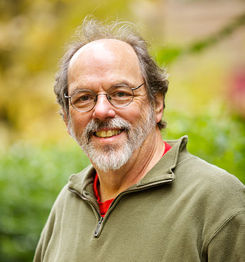
Refactoring wisdom!
Whenever you have to figure out what code is doing, you are building some understanding in your head. Once you've
built it, you should move that understanding into the code so nobody has to build it from scratch in their head again.
Ward Cunningham
(maybe)

Slide 50
C SETON LR
C MOVE '1' *INLR
C MOVE *ON *INLR
C EVAL *INLR = *ON
*INLR = *ON;

